Slide 1
CSE 262 Technology, Ethics, and Global Society Chapter 1 Critical Reasoning and Moral Theory Dr. Valerie Cross

Slide 2
Overview Points
Focus:
key ideas of eight moral theories,
fundamentals of ethical argumentation
Moral theories useful, can help one:
explain why one answer might be better than another.
figure out why one might find it difficult to agree with another person about the answer to a moral question

Slide 3
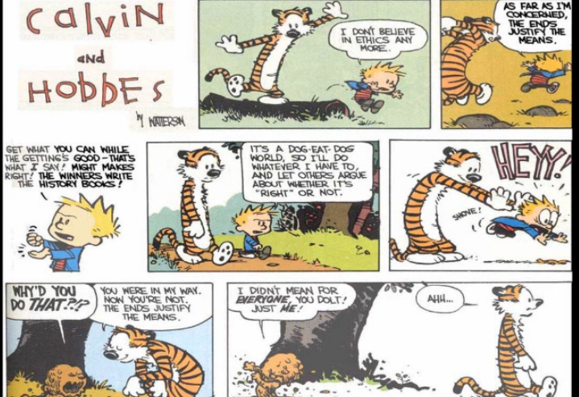

Slide 4
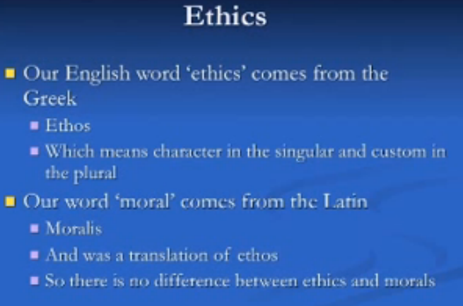

Slide 5
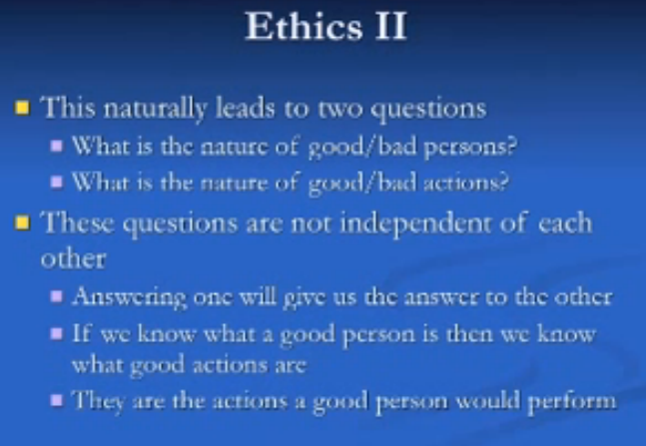

Slide 6
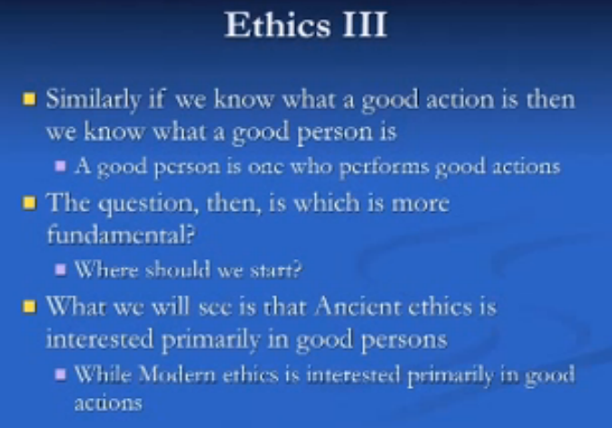

Slide 7
MORALITY AND ETHICS
Traditionally, ethics has referred to the philosophy of morality.
More recently ethics also used more broadly to refer to the ideals and rules of professional groups.
Definition for course:
Ethics is a set of morally permissible standards of a group that each member of the group (at his/her rational best) wants every other member to follow even if their doing so would mean that he/she must do the same (Davis, Profession, Code, and Ethics , 40).

Slide 8
MORALITY AND ETHICS
Morality, concerns the standards desired by all humans at their rational best.
Morality is the set of ethical rules that apply when the group includes all rational humans.
Definition::
Morality is the set of standards everyone (every rational person at his/her rational best) wants everyone else to follow even if their following them means having to do the same (Davis, Profession, Code, and Ethics , 41).

Slide 9
Morally Good vs Ethical?
“ethical” to express consistency with a particular standard.
an action might be unethical, but morally permissible.
EXAMPLE: ethical standards of physicians: doctors advertising their prices
Must weigh morally permissible action vs ethical obligation
one’s ethical duty to one’s profession might conflict with moral standards
Are there any standards that everyone wants everyone else to follow?

Slide 10
Moral Theory - way of defining morality
Defining morality essentially as an attempt to answer one or both of the following questions:
1. How do I know that X is good?
2. Why is X good?
In an ethical discussion, it is important to understand the underlying definition of morality that is being used and the group for which the ethical standards apply.
Abortion issue for Physicians vs Software Engineers.

Slide 11
Religious Ethics
Religious ethics refers to a set of ethical standards for the followers
of a particular religion
Some think teachings of their religion are all they need to make
ethical decisions, even in their professional lives.
In that case, they are equating ethical judgments for their profession with moral judgments (that is, ethical judgments that apply to everyone).
Ethical rules for most professions contain rules that are not moral rules
Ethical models must provide a way for anyone to do the right thing, regardless
of their religion

Slide 12
Thinking IT Through
Is it possible for a person who faithfully follows the rules of his or her religion to be immoral? Explain.
Is it possible for a person who faithfully follows the rules of his or her religion to be unethical? Explain.
Is it possible for a person who often violates the rules of his or her religion to be moral? Explain.
Is it possible for a person who often violates the rules of his or her religion to be ethical? Explain.

Slide 13
Divine Command Theory
The divine command theory is a moral theory that holds
that X is good because God commands it, and for no other reason.
Plato’s Euthyphro 4th century one of Plato’s early dialogues between
Socrates (469 BC – 399 BC) and Euthypryo, an ancient Athenian prophet.
“Is goodness loved by the gods because it is good, or is it good
because it is loved by the gods?”
Thomas Aquinas (1225 – 1274) considered the Catholic Church's greatest
theologian and philosopher believed that things are good in
and of themselves,
VS.
John Calvin (1509 – 1564) and Martin Luther (1483 – 1546)
held no standards for good and evil exist outside of God.

Slide 14
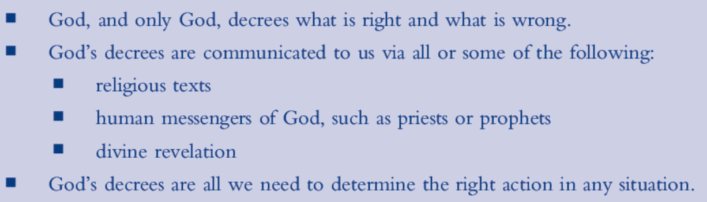
Key ideas of divine command theory
For the purposes of this course, we will not apply the divine command theory.
Our concern is primarily with the ethical standards of those who create or sell various kinds of technology, particularly computers and computer software, and by groups that use such technology in ways that affect the public.

Slide 15
Thinking It Through
Can a person who is not religious act morally?
Why or why not?
Can a person who is not religious act ethically? Why or why not?

Slide 16
Cultural Relativism
moral theory that holds that no valid rational criterion exists for determining the right thing to do.
Action judged good or bad based only on the standards adopted by one’s society.
Individuals may be judged by whether they conform to the standards of their culture
Different cultures cannot be judged against each other.
appears to promote tolerance of other cultures, BUT
Tolerance is the willingness to let people do what they wish, as long as there is no overriding justification to do otherwise.
Cultural relativism goes beyond tolerance, claims never any acceptable justification for one culture to override the wishes of another.

Slide 17
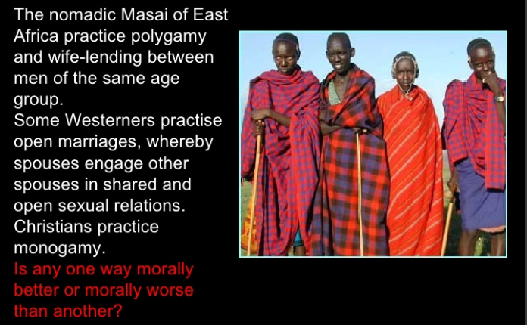

Slide 18
Language and Morality
two universal attributes of human culture:
Moral structures, like languages, differ substantially in their particulars
Moral structures, like languages, share many common elements.
Rules quite complex—too complex to articulate in a few simple statements.
all human cultures have some form of moral structure to include the same basic concepts.
Rules have exceptions and can be difficult to pin down, but they exist.
“natural morality” considered by some to be a gift of God and by others a product of evolution.
Linked to human beings not human culture

Slide 19
Bernard Gert, Common Morality i.e., Moral Universals
they all agree that killing, causing pain or disability, or depriving of freedom or pleasure to any other moral agent is immoral unless there is an adequate justification for doing such an action.
they all agree that deceiving, breaking promises, cheating, breaking the law, and neglecting duties also need justification in order not to be immoral.
These kinds of actions are immoral unless they can be justified.
Justifications for such exceptions vary across culture and are not convictions but products of reason and interpretation of evidence and are consequently subject to evaluation and comparison.

Slide 20
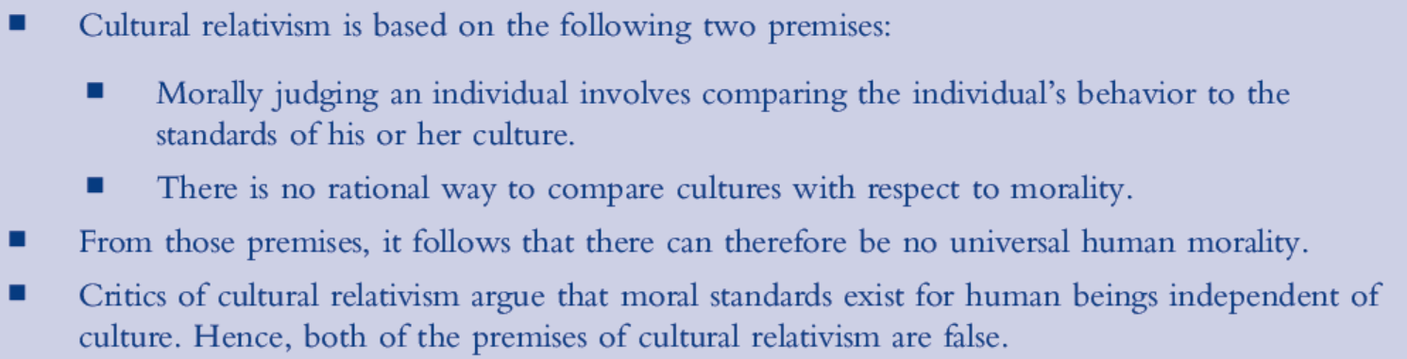
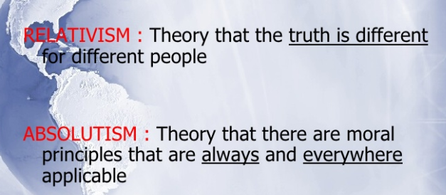
Key ideas of cultural relativism

Slide 21
Thinking It Through
One problem with cultural relativism is defining the boundaries of a culture. Clearly, anyone living in the United States today is living in a different culture than someone living in the society of the ancient Aztecs. But how about a man who as of today has lived all of his forty years in rural Alabama verses a woman who has lived all of her twenty years in New York City? Are they members of the same culture?
Give a collection of plausible heuristic rules for determining whether two people belong to the same culture

Slide 22
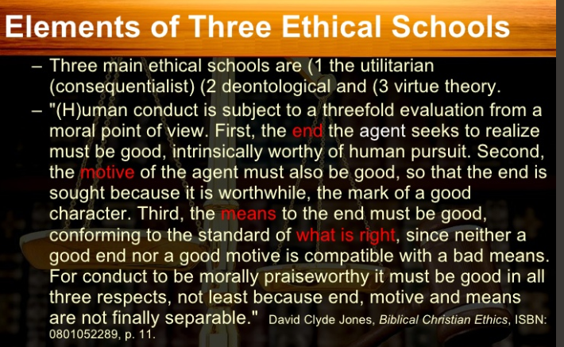

Slide 23
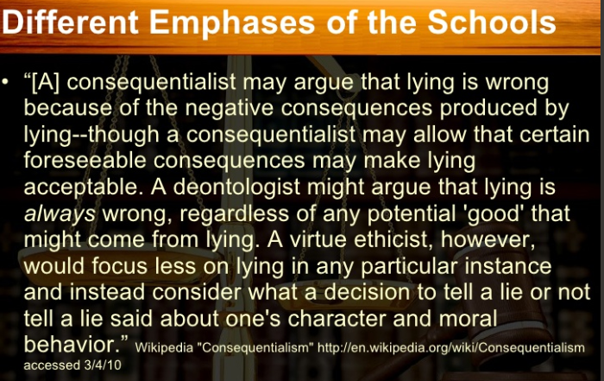

Slide 24
Virtue Theory
A moral theory that concerns the nature of virtue and what it means to have virtue.
Virtue is more about the nature of the person making a decision, rather than the decision itself.
Introduced by Plato (c. 428 – c. 348 B. C.) in ancient Greece but developed primarily by Aristotle (384-322 B. C.).
answers two questions:
What does it mean to be “good?”
How does one become good?

Slide 25
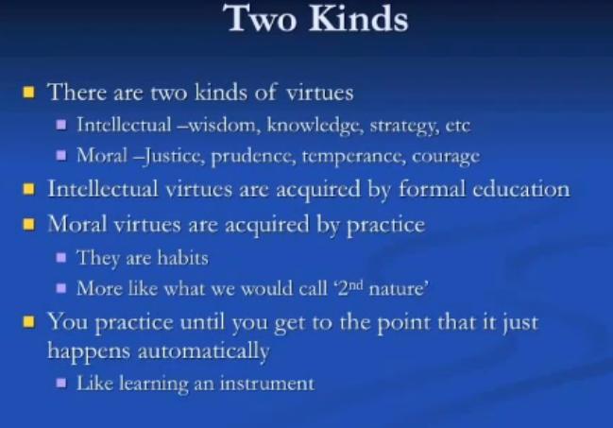

Slide 26
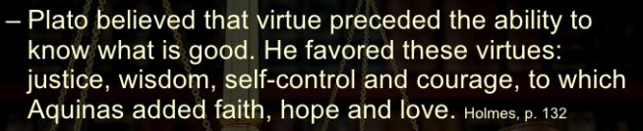
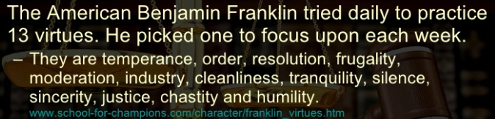
WHICH VIRTUES??

Slide 27
First question: What does it mean to be good?”
Aristotle’s approach: Try to list the virtues characteristic of a good person, such as
courage, friendliness, and modesty.
Each virtue is an ideal mean between two extremes of a human characteristic.
An ideal mean in this context means that it is the half-way point when one considers all relevant factors. For example, courage is the ideal between cowardice and recklessness

Slide 28
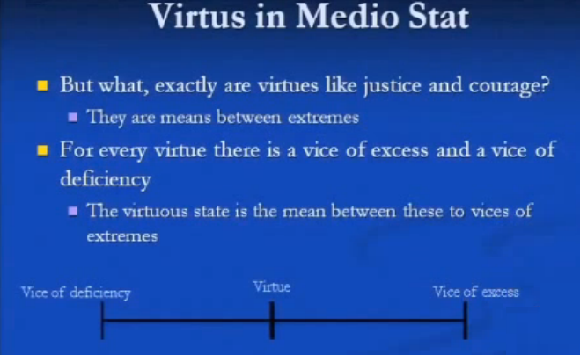
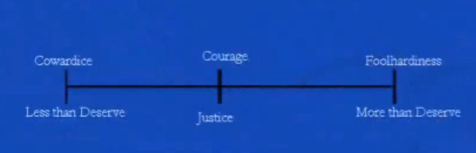

Slide 29
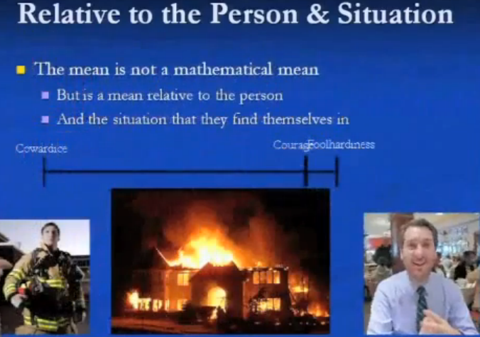

Slide 30
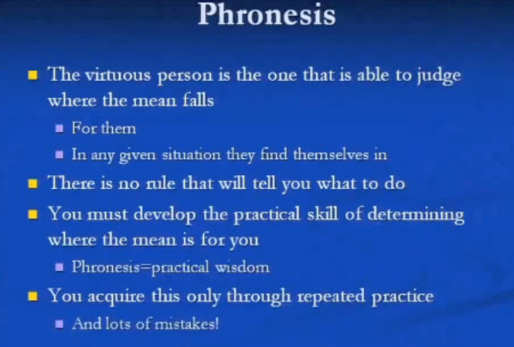

Slide 31
Second question: How does one become good?”
Aristotle says that there are two kinds of virtues:
intellectual virtues acquired through education,
character virtues developed by habitually acting according to the virtues.
Accordingly moral decision-making boils down to a basic question, “What would a good person do in this situation?” Ethical decision-making based on a virtue theory model of morality would be “What would a virtuous member of this group do in this situation?”

Slide 32
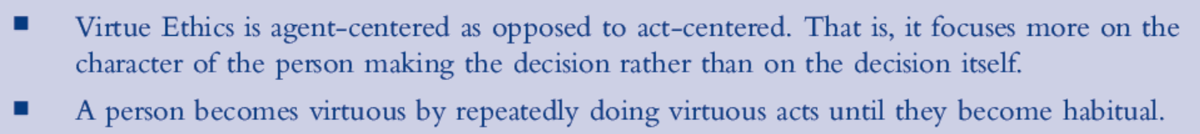
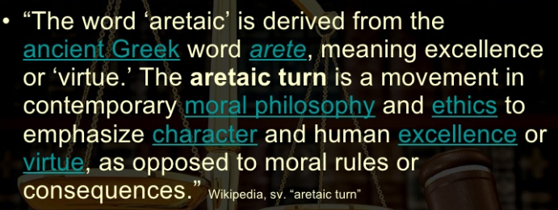
Key ideas of virtue ethics

Slide 33
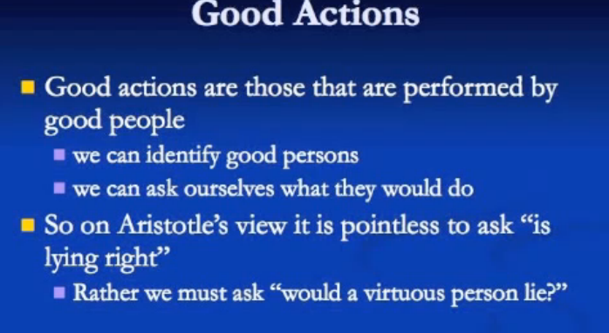

Slide 34
Utilitarianism and Consequentialism
In 1958 G. E. M. Anscombe (1919 -2001) introduced consequentialism in “Modern Moral Philosophy”
any theory of ethics that holds that the consequence of an action, not the motivation behind the action, makes the action good or bad.
Philosopher Jeremy Bentham (1748-1832) regarded as the father of utilitarianism
a consequentialist moral theory that says that the right decision is the one that causes the most happiness.
John Stuart Mill (1806-1873) regarded as its strongest proponent. The principle of utilitarianism says that one ought to do that which causes the greatest utility. Utility in this case means maximizing happiness in the world.

Slide 35
Defining Happiness?
According to Mill,
“happiness is…pleasure and the absence of pain,” whereas unhappiness means “pain and the absence of pleasure.”
important to understand that the pleasure referred to in utilitarianism is not simply physical pleasure but includes mental and emotional pleasure.
Since maximization of happiness occurs in the future as a consequence of the act, the nature of utilitarianism is necessarily predictive,
must be able to predict the consequences of a decision to determine significant degree the morality of our actions.

Slide 36
Two major categories of Utilitarianism
Act utilitarianism,
each ethical choice is evaluated according to whether or not the action taken maximizes happiness, compared to the other options.
Rule utilitarianism,
select a set of rules, and each act is evaluated as to whether it conforms to them.
Rules selected so as to maximize happiness if followed faithfully.
some allowed acts could, in principle, cause unhappiness, and hence be contrary to act utilitarianism. However, the aggregate of acts that follow the rules maximizes happiness, even if not entirely uniformly

Slide 37
Act Utilitarianism
greatest happiness principle, often phrased as “the greatest good for the greatest number.”
Process of calculating action leading to the greatest happiness is sometimes called utilitarian calculus. Calculations done frequently by ordinary persons. Factors complicating the calculation:
Some pleasures are different from others in quality, and so count either more or less than others.
Hard to know whether a particular action will actually make another person happier or not.
Many decisions affect thousands or millions of people for dozens or hundreds of years, which makes their impact on total happiness very hard to estimate.

Slide 38
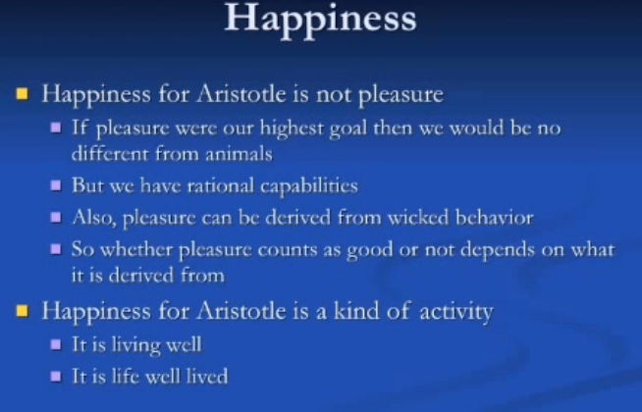

Slide 39
Difficulty of Utilitarianism Calculation Resulted in Rule Utilitarianism
Acceptance of act utilitarianism as a definition of morality suggests one has duty to try to be aware of relative information in decision making
If acting morally requires you to make such predictions, then acting morally would require you to prepare yourself for that as best you can.
Trying to be as capable as possible with such calculations is still very difficult to do. Making such calculations can lead to error. That was, in large part, the reason rule utilitarianism was introduced.

Slide 40
Thinking it Through
Suppose your friend has a valuable antique. She does not know it is valuable and throws it away. Would you then be at liberty to take it from her trash can? After all, to do so would not decrease her happiness because she has no knowledge of the article’s value. Support your answer using an act utilitarian argument.
Does being a utilitarian imply that one must accept the “no harm, no foul” principle? Explain why or why not.

Slide 41
Rule Utilitarianism
Basic premise is that easy-to-follow rules will lead to fewer calculations.
The rules can be examined at length by experts, and thus will increase utility (happiness) better than act utilitarianism
But in some cases individual acts may decrease utility.
adopt a set of rules and then violate them only in the case where compelling evidence indicates that utility is increased by such a violation.

Slide 42
Working Set Rules of common morality Bernard Gert
1. Do not kill.
2. Do not cause pain.
3. Do not disable.
4. Do not deprive of freedom.
5. Do not deprive of pleasure.
6. Do not deceive.
7. Keep your promises.
8. Do not cheat.
9. Obey the law.
10. Do your duty.

Slide 43
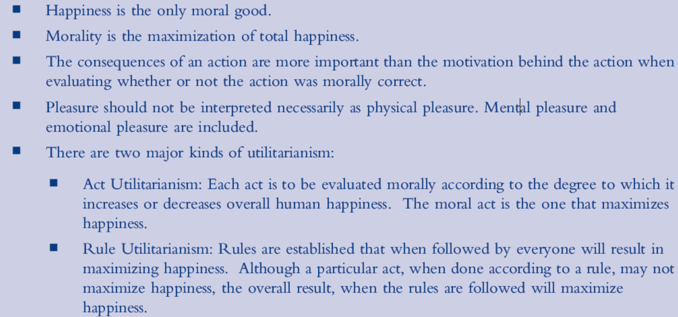
Key ideas of utilitarianism

Slide 44
Thinking It Through
Suppose you are in a lifeboat with several other act utilitarians. The lifeboat is overloaded and so the heaviest people in boat are thrown overboard until the lifeboat is no longer overloaded. Was that a moral act? Explain.

Slide 45
Deontological Ethics
focuses on rights, duties, obligations, and rules. Hence, according to these theories, some rules must be followed, even if following a particular rule would result in a bad end.
Many types of deontological ethics,
Examine the one expressed in the moral theories of the German philosopher, Immanuel Kant (1724-1804).
virtually all deontological theories owe something to Kant.

Slide 46
Deontological Ethics
Kant, differs from utiliarianism since he says “Nothing … [can] be called ‘good’ without qualification except a good will”
A good will in Kant’s terminology is the will of a person to act solely according to a code of morality based purely in reason.
Every act is thus moral or immoral according to whether it is consistent with the good will.
Since every being capable of rational thought ought to follow the same moral rules, he set out to find rules that could be proven correct simply based on reason and logic.

Slide 47
Categorical Imperative: Kant’s contribution
“Categorical” means absolute, unconditional, and an end in itself,
“imperative” means a command.
rule that must always be followed by all rational beings.
Two of Kant’s categorical imperatives:
Universal law of nature—Act only according to maxims (principles) that could be adopted as universal laws.
Principle of the end in itself—Treat humans, both yourself and others, always as ends in themselves, and never merely as a means to an end.

Slide 48
Universal law of nature
can be used to construct a mathematical-like proof that a maxim is not morally acceptable.
Example maxim “It is always morally acceptable to steal anything that you want.”
Kantian argument:
If it is okay to steal, then we should not expect to have any personal property.
If there is no such thing as personal property, then there is no such thing as “stealing.”
Hence, the maxim is logically invalid; either there is no such thing as stealing (so the maxim is invalid), or stealing is wrong (so the maxim is invalid).

Slide 49
Moral Quandaries with Deontological Ethics
As with consequentialism, deontological ethics can lead us into a number of moral quandaries.
The lack of exceptions to the rules is a particular problem with deontological ethics.
Example: Lie to killer at the door.

Slide 50
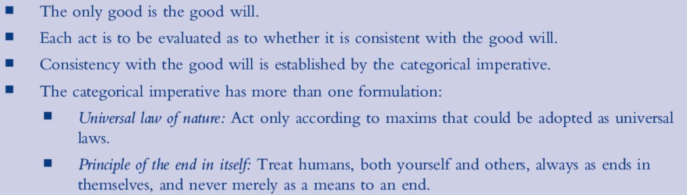
Key ideas of deontological ethics

Slide 51
Thinking It Through
Suppose student A asks to copy student B’s paper, and student B agrees. Using the principle of the end in itself, argue that both students (not just student A) have acted immorally.
Consider the maxim “It is always morally acceptable to lie.” In the spirit of the universal law of nature, prove that this maxim cannot be universally adopted. (Hint: If everyone lied whenever it was convenient, would lying still be useful?)

Slide 52
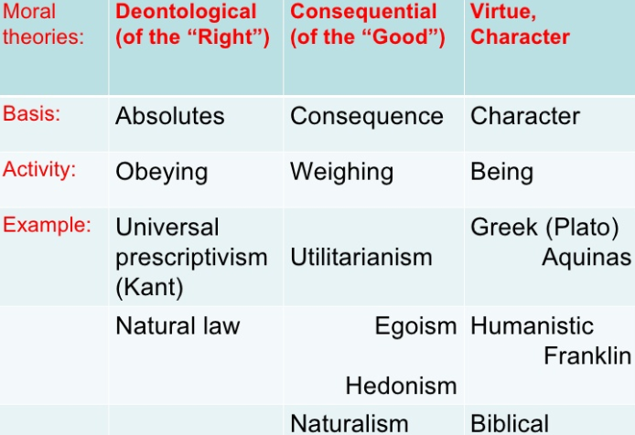

Slide 53
Contractarianism
Both a political theory and a moral theory
Some of its attributes can be merged with consequentialist theories or with deontological theories, i.e., contractarian versions of each.
Stems from English philosopher Thomas Hobbes (1588-1679).
Premise: people are rational beings who wish to promote their own self-interests, and the best way of doing that is to promote the common interests of society.

Slide 54
“Contracts”
enter into contracts in which each party agrees to certain obligations in exchange for other benefits.
Such contracts are often implicit (that is, never explicitly articulated) but are real and enforced by social norms and by political institutions.
The claim: in this way, a person can serve his or her own self-interest while at the same time acting for the public good.

Slide 55
Game Theory
“Is a person’s self-interest really maximized by acting for the public good?”
A branch of mathematics in which an individual (a player) makes choices that potentially create points for the player. The number of points a player wins depends on his or her choices and on the choices of other players.

Slide 56
Prisoner’s Dilemma Robert Axelrod Version
Two prisoners are being held by police in the investigation of a crime. Each is interrogated individually and given the following choices.
1) If you both testify against the other, your prison sentence will be five years each.
2) If both are silent, you will both get six months.
3) If only one testifies, then that prisoner will go free and the other prisoner will get 10 years.
problem with using the prisoner’s dilemma as a refutation of social contract theory is not a satisfactory model of the world. The problem, as presented, is a one-shot decision.

Slide 57
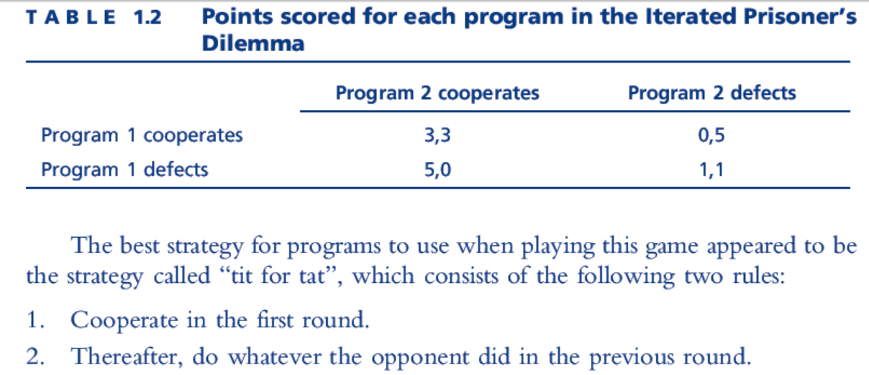
Iterated Prisoner’s Dilemma
Idea of one’s self-interest being served by cooperating with one’s peers is at least plausible,
Does not prove that cooperating with one’s fellow humans is the best policy,
Suggests that the long term winners are those who retaliate when exploited, but otherwise cooperate for the common good, even if they risk personal loss in the short run.

Slide 58
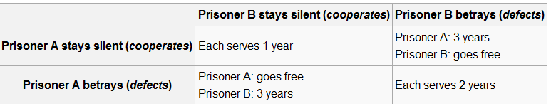
Another Prisoner’s Dilemma

Slide 59
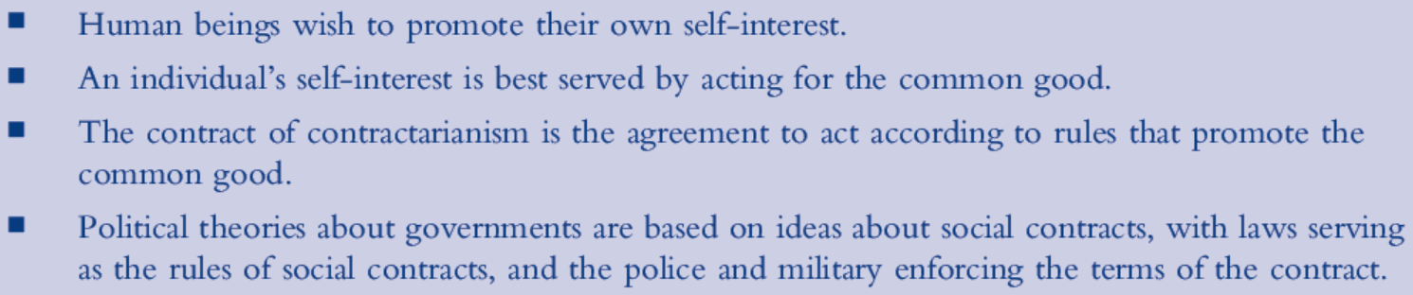
Key ideas of contractarianism

Slide 60
Ethics of Justice
search of ethical theories that have two key qualities:
Impartiality—Every person is treated equally and no one is given preferential treatment in the theory.
Universality—A decision reached by applying the theory should be correct for everyone that has a similar decision to make.
Many of our social systems are designed to be intentionally partial to one group or another■
Is it morally permissible to award college scholarships based on academic merit or financial need?

Slide 61
Contractarian John Rawls: A Theory of Justice,
All social contract theories of ethics must share a common core: the society should be fair.
Argues two principles of justice as fairness underlie all just societies. :
Each person should have as extensive a set of basic freedoms as possible, as long as it does not prevent others from having the same freedoms.
Social and economic inequalities are justified only if:
Everyone has a fair chance to obtain the better position.
Such inequalities provide the greatest benefit to the least advantaged; this is known as the difference principle.
Principles applied in order stated.

Slide 62
Rawl’s Veil of ignorance
Thought experiment: What if, before you were born into the world, you got to choose a social contract? What kind of contract would you choose?
Rawls further stipulates, however, that you must make this decision in complete ignorance of what qualities you will have once you are born.
You do not know how smart you will be, or
How rich, or whether you will be healthy.
Randomly assigned to a lot in life.
Argues that, from behind this veil of ignorance, any rational person’s choice of social contract would include his two principles. .

Slide 63
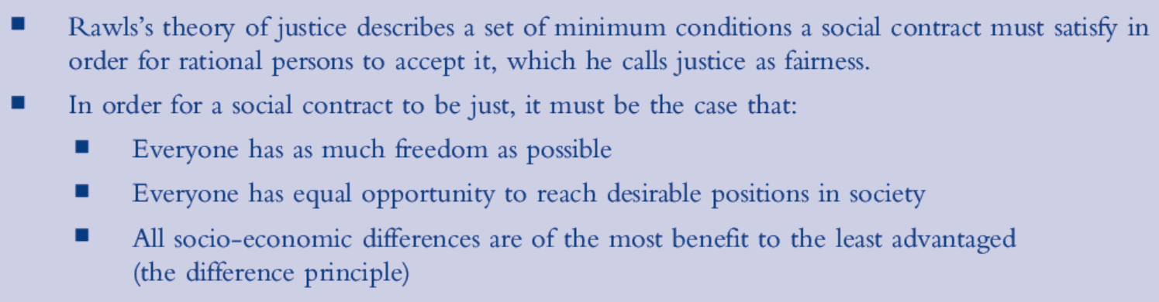
Key ideas of Rawls’s theory of justice
Not a moral theory for individuals,
A way of evaluating various possible social contracts.
Rawls would claim that a “just” or “fair” social contract must follow his principles.

Slide 64
Thinking It Through
Imagine a strange culture where at birth a new baby had his or her education, marriage arrangements, and career decided by a computer program that randomly assigned such things to individuals. Every person earned exactly the same salary and any kind of application for schools or jobs was handled by computers choosing people at random. Would that society be a just society according to Rawls? Explain.

Slide 65
Nel Noddings’s Ethics of Caring
Course textbook uses this approach
Critical of the utilitarian and Kantian approaches to morality
These are popular due to trying to prove things about moral decisions using math, science, logic, which are not helpful for teaching real people how to actually act morally
Morality boils down to achieving a single moral ideal, a single virtue, caring for other individuals.
Noddings proposes an ethics of caring, which defines goodness in terms of whether or not we taken care of the people around us.
Caring is the only inherent good
Kant holds that a “good will” is inherently good,
Utilitariansc onsider happiness to be inherently good

Slide 66
Ethics of Caring
“We want to be moral in order to remain in the caring relation and to enhance the ideal of ourselves as one-caring.”
By one-caring, Noddings means someone who fulfills the role of a caregiver in their interactions with others; “one-caring” refers to that role.

Slide 67
Points to Ethics of Caring
Characterized by a feeling of engrossment in the needs of another person and by acting to care for the person based on their situation, by the one-caring.
For caring to happen, the cared-for person must be receptive to being cared for.
Possible to “care about” everyone, not possible to “care for” everyone. Morally acceptable to be partial, to only care for a relatively small number of individuals.
Caring involves being engrossed in the specific situation of a specific individual and does not lead to universal moral rules.

Slide 68
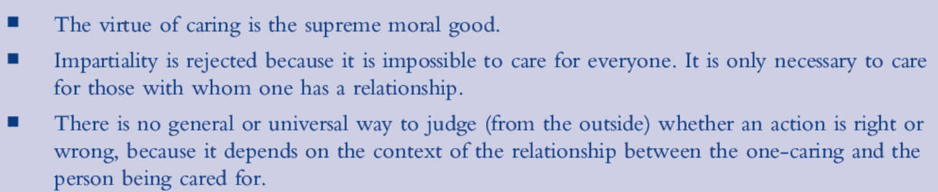
Key ideas of Noddings’s ethics of caring
Rawls vs Noddings ethics
Rawls focuses on institutions and what a just institution should look like
Noddings focuses on how we relate to other particular individuals
to be moral is to care for (and receive caring from) those we relate to.
Ethics of caring is the hardest for most computer professionals to put into practice.

Slide 69
Practical reason
The reasoning used to make decisions.
Unlike with pure reason, in the realm of practical reason, benefit of common axiom not available and the rules of inference are sometimes in dispute
Aristotle made a distinction between deliberation which is a form of practical reasoning, and syllogistic reasoning, which is reasoning appropriate for the sciences
Deliberative critical discussion starts with the premise that intelligent, knowledgeable, well-intended people who think carefully and rationally about an ethical issue may disagree.

Slide 70
Deliberation guidelines
the goal is to understand their position and to help them understand yours.
Everyone is a well-intended,rational person who deserves your respect.
Avoid rhetorical devices intended to persuade without a rational substantive

Slide 71
Ethical Arguments and the Importance of Context
Ethical argument similar to a legal argument,
evidence is presented, arguments are disputed, and exceptions to rules are common.
BUT.
Legal arguments relate to a single set of statutes and previous decisions by judges and juries.
Ethical arguments sometimes involve interactions among several different moral theories or codes of ethics.
Example importance of context: Harassing black drivers

Slide 72
Reasoning by Analogy: Casuistry and Circumstantial Reasoning
The case-analysis approach to the interpretation of general moral rules.
Casuistry starts with paradigm cases of how and when a given general rule should be applied, and then reasons by analogy to cases in which the proper application of the rule is less obvious…
approach ethical problems by looking at various cases and using them as paradigms.
In deliberative critical discussion, arguments will serve as investigations that seek to establish the truth to the extent possible.

Slide 73
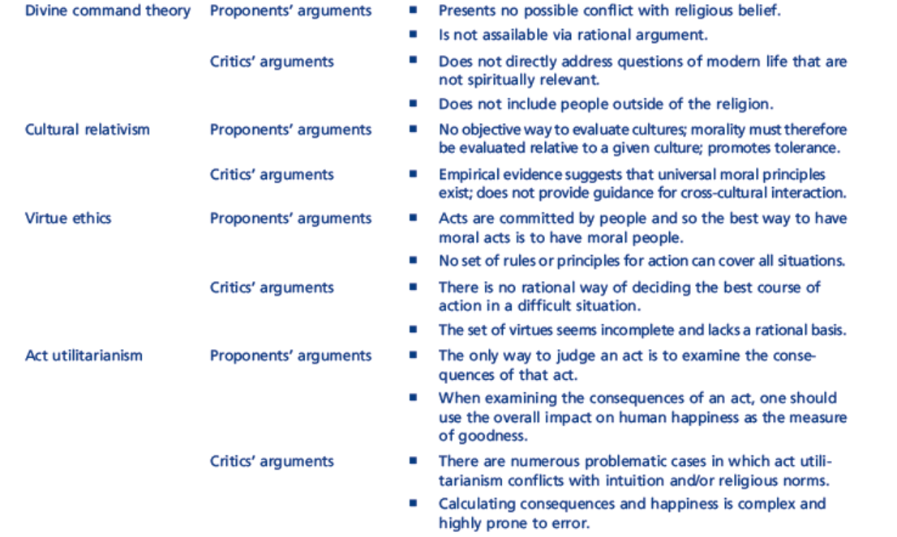
Moral Theories Summary

Slide 74
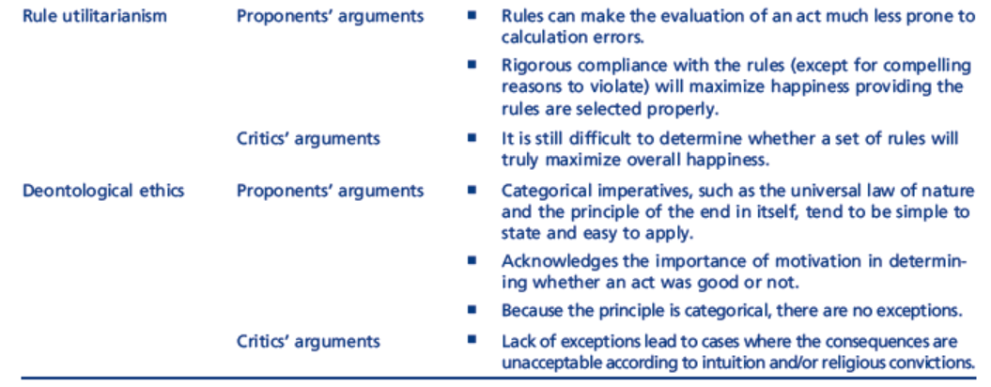
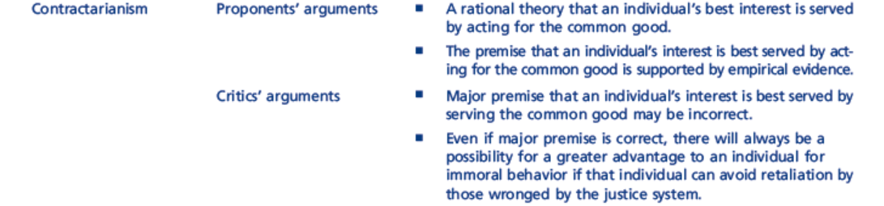
Moral Theories Summary Continued

Slide 75
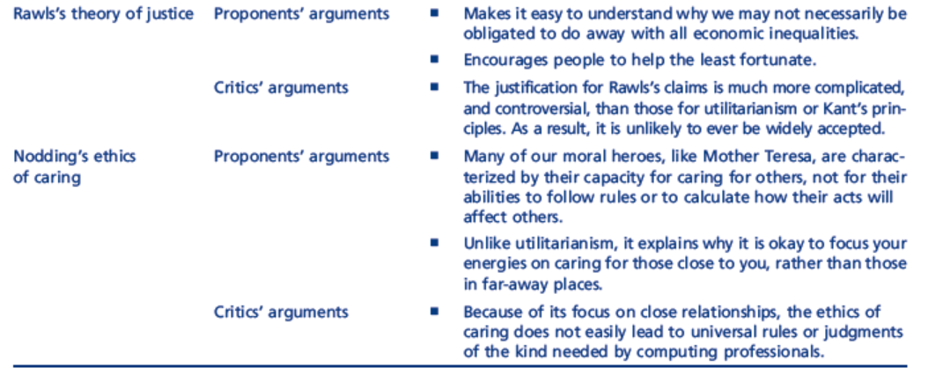
Moral Theories Summary Continued

Slide 76
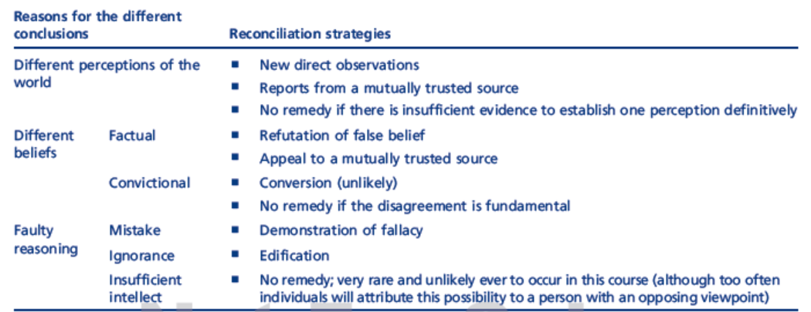
Conclusion differences in Critical deliberative discussion

Slide 77
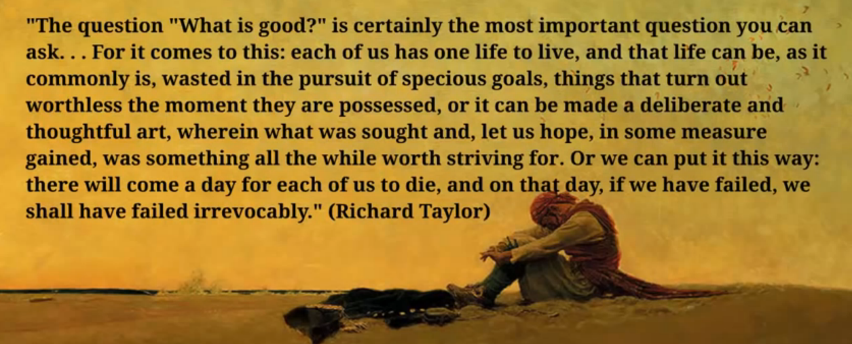
WHAT IS GOOD?

